Slide 1
Programme on
PREDICTIVE MAINTENANCE
Approach, Measures & Methods

Slide 2
MAINTENANCE
Role of maintenance – major changes.
Goals of maintenance :
Maintenance activities : to fix failures
to prevent failures
Improvement activities :
to extend life span of machine parts
to shorten maintenance time
to avoid maintenance

Slide 3
MAINTENANCE
Maintenance activities
a. Activities to prevent deterioration
b. Activities to measure deterioration
c. Activities to restore deterioration

Slide 4
MAINTENANCE
Measures of effectiveness
Reduced cost of operations
Higher availability of machines
Increased Life span of equipments
Reduced Total Life cycle cost of equipments.

Slide 5
MAINTENANCE
Types of maintenance
Breakdown maintenance
Corrective maintenance
Preventive maintenance
Predictive maintenance

Slide 6
MAINTENANCE
Types of maintenance
Breakdown maintenance :
Repairs done on equipments before any maintenance is carried out
Unscheduled maintenance – cannot be planned
Can create problems to related components or parts
To be avoided as it increases cost of maintenance &
deteriorates machine life.

Slide 7
MAINTENANCE
Types of maintenance
Corrective maintenance :
Repairs done on equipments after inspection of machine or during preventive maintenance.
Helps in correcting the defect or defective part before a breakdown occurrence.
Can reduce availability as it may increase preventive maintenance time.

Slide 8
MAINTENANCE
Basic shift in concept
ALL EQUIPMENTS
EVENTUALLY
BREAKDOWNS
EQUIPMENTS
SHOULD
NEVER BREAKDOWN

Slide 9
MAINTENANCE
Maturity ladder
Eliminate failures
Predict failures
Prevent failures
Correct failures
Understand failures
Attack failures
Paradigm shift – Move from Attacking to understanding
Move from sudden unplanned failures to Prediction & Elimination

Slide 10
MAINTENANCE
Types of failures
BREAKDOWN
NATURAL B / D
Wear & tear
Life expiry
Predictable
FORCED B / D
Lack of skill
Lack of knowledge
Lack of Attitude
Unpredictable

Slide 11
MAINTENANCE
Types of failures
FUNCTION REDUCTION B / D
Specific parts are affected
Not a complete Failure of machine
Machine is running, but not at full potential
Not considered as a loss
Creates major losses
Affects routine performance
FUNCTION LOSS B / D
Sudden stoppage of machine
Creates Production loss

Slide 12
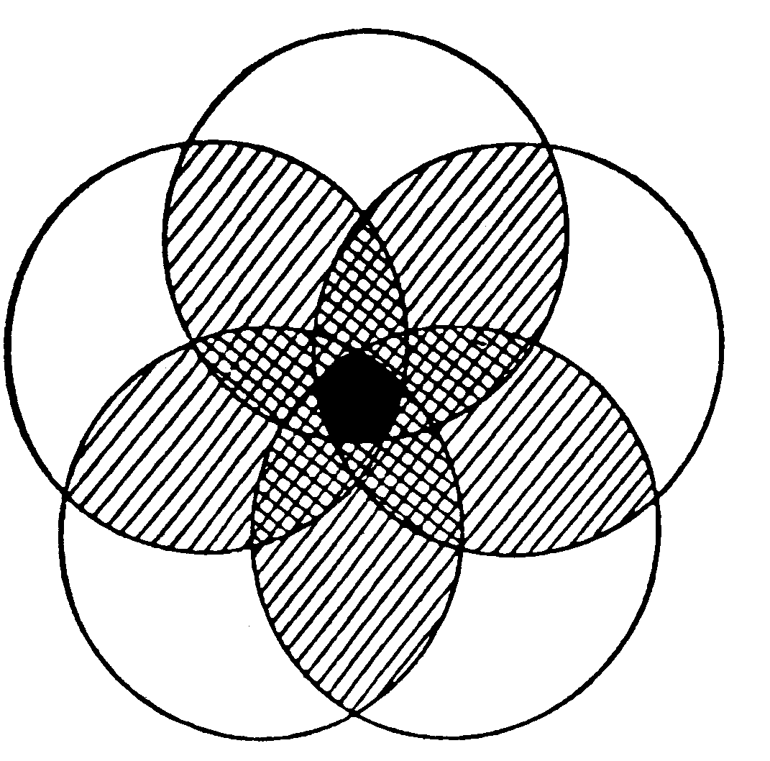
MAINTENANCE
Causes of failures
A
Λ
B
Λ
C
Λ
D
Λ
E
ZONE
Basic
ZERO BREAK
B
condition
DOWN
neglected
A
C
Operating
Inadequate
standards
skills
not followed
E
D
Deterioration
Inherent
unchecked
design
weakness

Slide 13
Scheduled Maintenance
HIDDEN DEFECTS INVISIBLE
[B / D BY CHRONIC]
EXPOSING HIDDEN DEFECTS
THRO OEE
HIDDEN DEFECTS AREAS MAJOR
CAUSES OF BREAKDOWN
[JUST LIKE
UNEXTINGUISHED
CIGRATEE]
DEFECTS CAN BE PHYSICALLY (OR)
PSYCHOLOGICALLY HIDDEN

Slide 14
MAINTENANCE
Barriers to effective Maintenance
Problem exists and known, but say it cannot be rectified

Slide 15
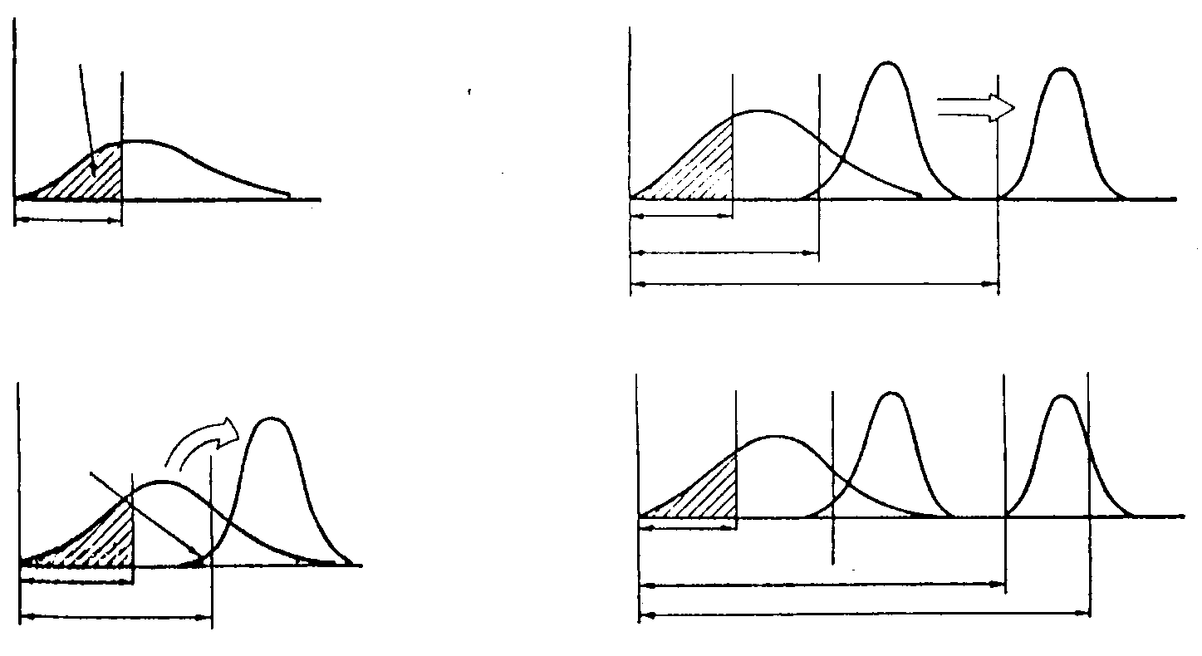
MAINTENANCE
Four Phase development
FROM ACCELERATED DETERIORATION
ESTIMATE POTENTIAL LIFE SPAN
LENGTHEN EQUIPMENT LIFE
FIND TRUE DESIGN WEAKNESS
P/M IS MORE EFFECTIVE
NATURAL DETERIORATION
Phase 2: Lengthen equipment life span
Breakdown occurs here
(
c
)
(
a
)
Replacement Period
Replacement Period (1)
Phase 3 : Restore Periodically
Replacement Period (2)
Replacement Period (3)
Predictive Maintenance
Phase 1 Stabilize MTBF
:
(
d
)
Breakdown only
(
b
)
occur here
Replacement Period (1)
Phase 4
Replacement Period (2)
Predict breakdowns
Replacement Period ( 1)
Replacement Period (2)
-
Replacement Period (3)
Predictive maintenance
Non-periodic replacement based on predicted life

Slide 16
MAINTENANCE
Requirements of TS 16949
- Effectiveness & Efficiency
Total preventive maintenance
Through Predictive maintenance methods.

Slide 17
MAINTENANCE
Measures of maintenance process
Reliability
- MTBF : increase Mean Time Between Failures
b. Maintainability
- MTTR : decrease Mean Time To Repair

Slide 18
MAINTENANCE
Measures of maintenance process
Reliability - MTBF : Mean Time Between Failures
MTBF = Total operating time / Total failure counts
Analysis of repetitive breakdowns – 5 why’s, FMEA
Reduction of overall Failure trend through elimination
of failures.
Outputs – Maintenance Prevention (MP) Kaizens

Slide 19
MAINTENANCE
Measures of maintenance process
Maintainability - MTTR : Mean Time To Repair
MTTR = Total stoppage time / Total failure counts
Time to repair
Response time
Diagnosing time
Repair time
Trials & Adjustment

Slide 20
MAINTENANCE
Measures of maintenance process
Maintainability - MTTR : Mean Time To Repair
Activity analysis – Value , Non value adding
Outputs
Maintainability Improvement ( MI) Kaizens
Improved diagnosis methods
New or modified tools for repair
Modular concepts

Slide 21
MAINTENANCE
Towards Predictive maintenance
Sustaining MTBF & MTTR improvements
Include solutions into Preventive Maintenance
Standards
Preventive maintenance types :
a.Scheduled maintenance
TBM :Time based maintenance
b. Maintenance by monitoring
CBM : Condition based monitoring

Slide 22
MAINTENANCE
TBM –Time Based Preventive Maintenance
Also called Scheduled maintenance.
Process of periodic overhauls or service of the
equipment.
Activities include anything from Lubrication to
replacement of parts as per set time periods.
Time periods could be Number of shifts, Number of
hours run or number of units produced.
TBM done for parts whose Life can be fixed.
Inputs include - manufacturers recommendation or
past experience.

Slide 23
MAINTENANCE
CBM –Condition Based Preventive Maintenance
Also called Monitored maintenance.
Monitors the condition of the part or equipment.
Applicable for parts for which Life cannot be fixed
Wearing out is monitored and replacement is
estimated as per condition existing.
System helps in making logical decisions about
replacement and cuts down production loss hours.
Parts need to be changed, if not leads to certain
failure.

Slide 24
MAINTENANCE
Preventive & Predictive Maintenance
Maintenance
Renewal
Routine
Repair
Inspection
Adjustment
Lubrication

Slide 25
MAINTENANCE
Predictive maintenance
Predictive maintenance involves Inspection as a
means to predict failures.
Inspection consists of Visual inspections or use of
Condition monitoring techniques.
Uses 5 senses to pick up signals indicating failures.
Employs modern methods and signal processing
techniques to accurately diagnose equipment
condition.

Slide 26
MAINTENANCE
Goals of Predictive maintenance
to reduce breakdowns and accidents caused by
equipments
- to increase operating times & production
to reduce maintenance time & costs
to increase the quality of products & services.

Slide 27
MAINTENANCE
Predictive maintenance process
Select area ( or part) of the equipment to be
monitored.
2. Decide suitable Diagnostic system.
3. Develop equipment diagnostic skills among
maintenance personnel.
4. Change TBM parts into CBM parts.
5. Consolidate CBM
6. Implement the monitoring system & record.

Slide 28
MAINTENANCE
Predictive maintenance process
Selecting the part of the equipment for predictive maintenance
PM should be used only on components whose
failure will lead to long periods of downtime.
Critical components selection basis :
a. Quick availability
b. Procurement lead time
c. Item type – Drawing based to be developed
Standard item but not easily available
Standard item & easily available

Slide 29
MAINTENANCE
Predictive maintenance process
Equipment diagnostic techniques
Non – destructive
Liquid penetrant
Magnetic particle
Ultrasound
Vibration analysis
Oil analysis

Slide 30
MAINTENANCE
Equipment diagnostic techniques
Non – destructive - Liquid penetrant
Used for detecting surface cracks and subsurface
cracks that have a opening to the surface.
Surface is cleaned and applied with a suitable dye.
Dye is allowed to penetrate for some time.
Developer is added over the dye.
Cracks are inspected.

Slide 31
MAINTENANCE
Equipment diagnostic techniques
Non – destructive – Magnetic particle
Uses principle of magnetic fields to indicate defects.
Can be used only on materials that can be
magnetized.
Surface to be tested is cleaned.
Develop magnetic field on the part
Apply magnetic particles to the part
Examine for defects.
Particle flow gets disturbed in areas of defects.

Slide 32
MAINTENANCE
Equipment diagnostic techniques
Non – destructive – Ultrasound testing
Uses high frequency sound waves transmitted into or
through the part.
Results indicate – thickness of the part and
subsurface flaws.
Useful for thick & heavy materials.
Used by both maintenance & quality.

Slide 33
MAINTENANCE
Equipment diagnostic techniques
Non – destructive – Vibration Analysis
Most commonly used diagnostic technique.
Indicates the level of vibration and the cause of it.
Measured in terms of Frequency & Amplitude.
Used for Motors, frames, pumps etc.
Indicates defects such as
Unbalance, misalignment, looseness, bend shaft
defective bearings.

Slide 34
MAINTENANCE
Equipment diagnostic techniques
Non – destructive – Oil Analysis
Indicates equipment wear level.
Samples of Lubrication oil or Hydraulic oil are tested
for contamination.
Contaminated oil becomes itself a source for
accelerating wear.
Spectro-chemical analysis – analyses particles to
find out the material they are made of.

Slide 35
MAINTENANCE
Component diagnostic techniques
Bearings
Overheating
Lubrication
Shaft & Housing fits
Misalignment
Noise
Contamination
Vibration

Slide 36
MAINTENANCE
Component diagnostic techniques
Chain drives
Normal wear – of pins, links
Elongation
Tension – slackness or deflection
Sprockets
Noise
Lubrication

Slide 37
MAINTENANCE
Component diagnostic techniques
Belt drives
Normal wear – cuts, hairiness
Elongation
Tension – slackness or deflection
Alignment
Pulley lubrication

Slide 38
MAINTENANCE
Predictive maintenance
Benefits to be achieved
Life extension of equipments
Reduced cost of maintenance
Reliability improvements
Maintainability improvements
Spare inventory reduction
Improved maintenance skills.

Slide 39
MAINTENANCE
Beyond Predictive maintenance
Maintenance improvement activities
Extending life span of parts
Correcting weakness such as
- lack of strength
- design defects
- processing defects.

Slide 40
MAINTENANCE
Beyond Predictive maintenance
Maintenance improvement activities
b. Shortening Maintenance time
- skill development
c. Avoiding Maintenance
Zero failures of priority equipments.
Improving Quality & Productivity

